Slide 1


Notes:
1. Table of contents
2. Introduction
3. Our company
4. Our team
5. Problem
6. Them vs. us
7. Solution
8. SWOT analysis
9. Product overview
10. Our plans
11. Product demo
12. Traction
13. Case study
14. Reviews
15. Awards
16. Market size
17. Target
18. Competitors
19. Business model
20. Timing
21. Predicted growth
22. Investment

Slide 2


OUR TEAM
/ Javier Herdocia
/ Reiniel Fernandez
/ Gustava Zapata
/ Mario Orellana

Slide 3
Our Purpose
Xfit seeks to provide Users both new and experienced, a more efficient way to help keep track of exercises they wish to add to their weekly routine.
Exercises can be searched efficiently through use of filtering options provided to the user such as favorite exercises, exercises that work on a specific muscle, and exercises that use equipment in which the user has access to.
All exercises will feature a detailed description, steps, and diagram(s) on how to properly perform them.

Slide 4
Target Audiences
The intended users of this web application are:
Beginner users who will find the provided descriptions of each exercise useful when planning a routine.
Experienced users who would have a better quality of life experience being able to organize workout routines.
Administration users would use this application to make manual changes to application provided exercises and equipment.

Slide 5
THEM VS. US
/ THEM
/ US
Most similar applications don’t provide the same level of efficiency when it comes to finding exercises best suited for a user.
XFit features multiple different options for users to find the right exercise for them to add to their routine.

Slide 6
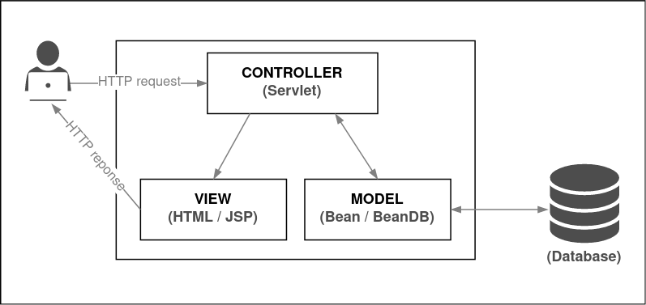
Web Architecture
XFit is a web application using jsp driven web pages to provide front end view functionalities for end users.
Our architecture is based off of a standard MVC design pattern (Model-View-Controller) where different components will handle different functions of the application.
Actions done by the user will be processed and handled by the Controller.
The model will act as the backbone of our application defining class properties and methods.
The database will store all exercise, equipment and user information.

Slide 7
Technologies Used
Java (Implementation Language)
Servlets/JSP (Web Server API)
Apache Tomcat (Web Server)
JPA-Hibernate (Database API)
PhpMyAdmin (GUI Database Administration)
MariaDB (Database Management System)
VS Code (IDE)
Docker (Virtualization component)
Git (Repository)

Slide 8
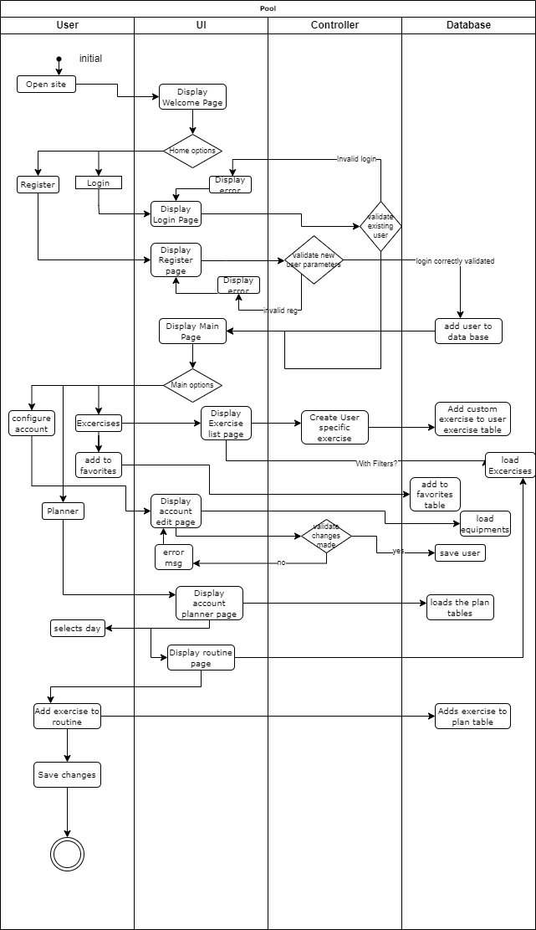
High Level Flow and product functions
User visits web page and registers with a strong password, username and email.
Users must confirm their email with a validation code.
Users can view exercise details by visiting the exercise list page. Here users can add exercises to their favorites.
Users can filter exercises by favorites, equipment owned, or by specific muscles. This can be done in the exercise list or in the plan pages.
Users can visit the plan pages to add exercises to their routine.
Users can at some points create custom exercises that only feature a title and description.
Users can make changes to any equipment they own.
Users can configure their password and username.

Slide 9
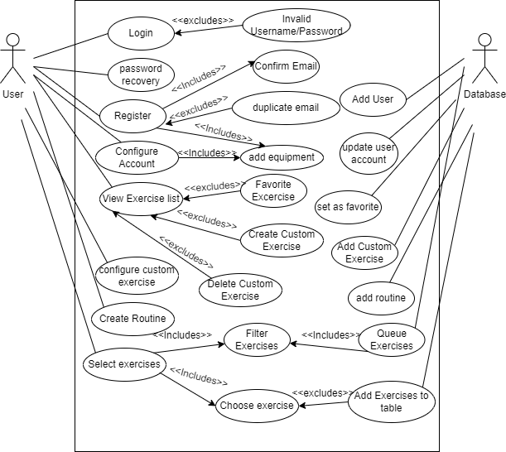
Use Cases
Use Case #1: Logging In
Use Case #2: Registering
Use Case #3: Viewing Exercise List
Use Case #4: Configuring Account
Use Case #5: Plan
Use Case #6: Creating Custom Exercise
Use Case #7: Editing Custom Exercise
Use Case #8: Logging Out
Use Case #9: Today’s Workout

Slide 10
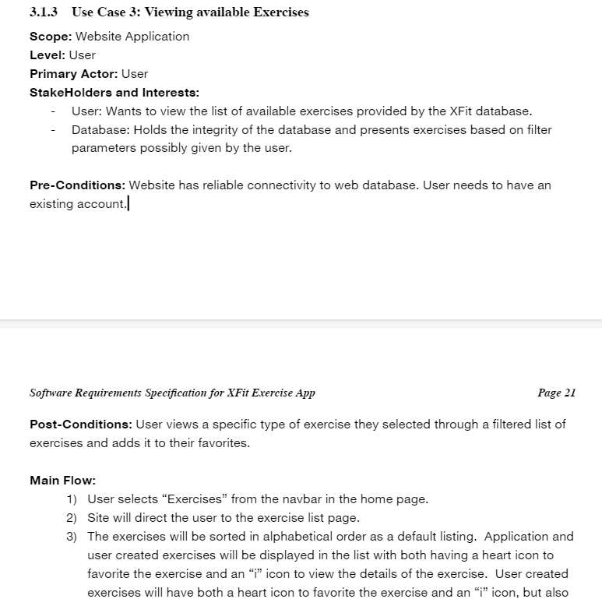
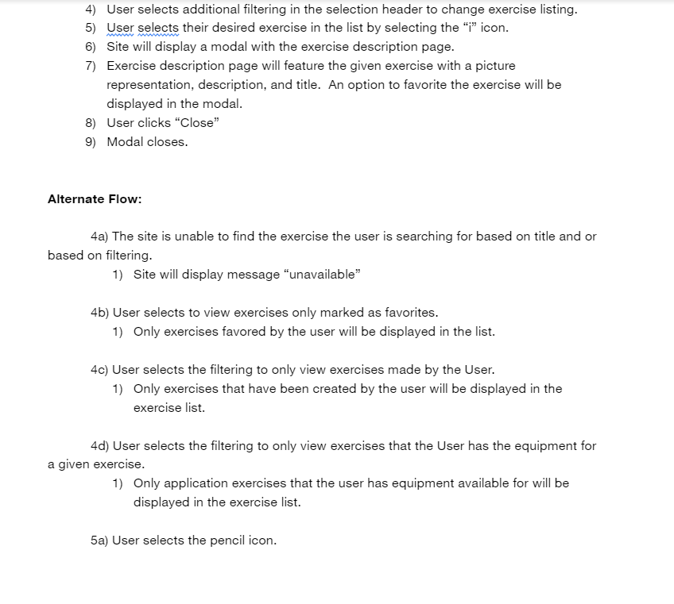
Use Case #3 Example

Slide 11
Dependencies and Assumptions
Users of XFit are assumed to have a computer with internet connection.
Users' familiarity with the terminology and the names of the routines is expected as this is not a training or educational application, it is for users who have a basic idea of exercises and equipment routines.
XFit uses exercises from a third-party database and therefore it must follow their rules and terms of use.
In order to use the main features of our application, a user must have a registered and verified account.
In the first version only, the English language will be supported.
Users must have an existing email account in order to have full site functionality
Once a user has registered and verified an email address, for the initial version of this application a user cannot change their email address.
Equipment choices, Workout plans, and User custom exercises are exclusive to each user and cannot be shared among users.
Users are assumed to be able to manually remove exercises from their routine if they want a type of routine that will reset at the end of a given day.

Slide 12
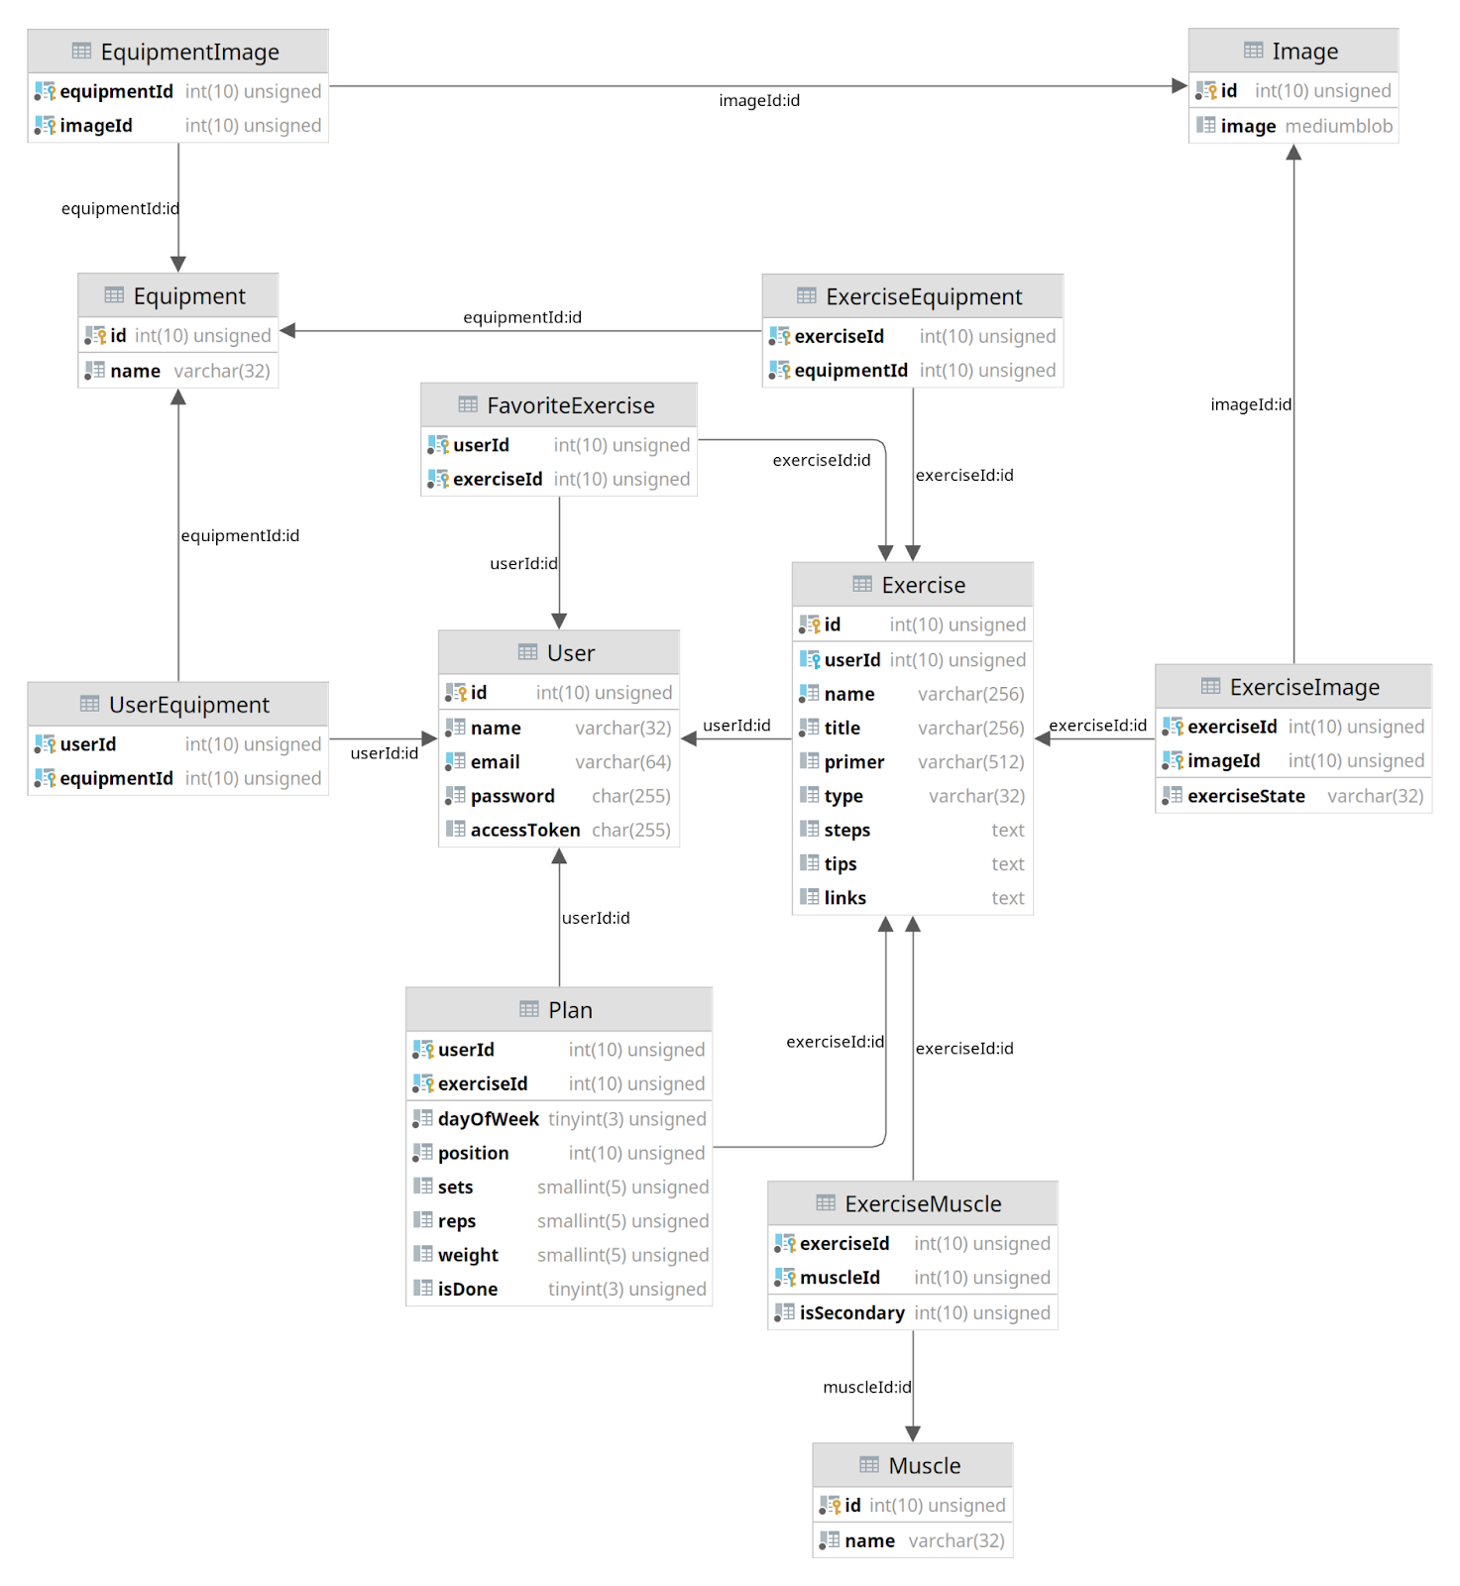
Data Design
Our data design includes making tables that represent the primary domain classes of our application.
Such as User, Equipment, Exercise, Images, etc.
Joint tables between these major domain classes represent the associations between them.

Slide 13
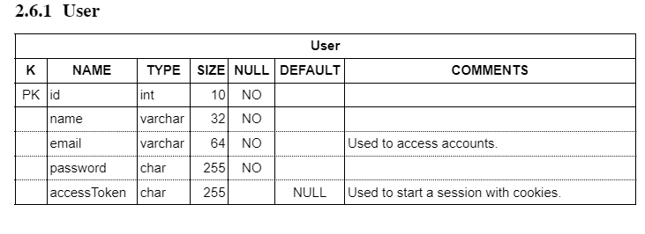
User Table Example
The id column of the user is the primary key as an integer time.
The name, email, and password columns are varchar types indicating text variables and they cannot be empty.
The access token can be null and is filled when the user has decided for automatic login.

Slide 14
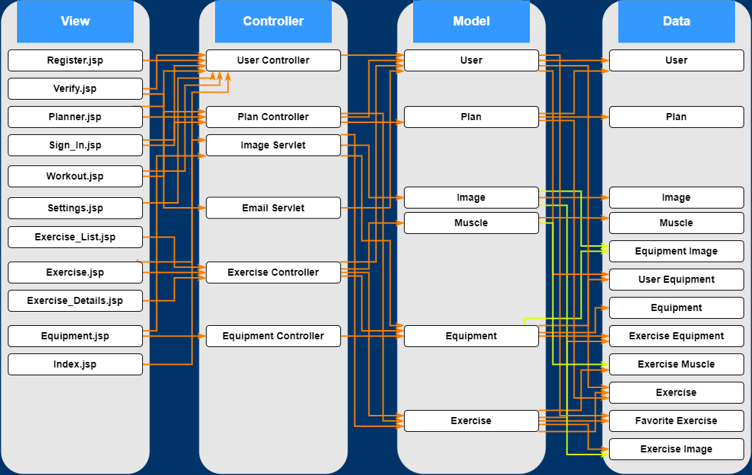
Architectural Strategies
The controller handles requests made by the view components.
The controller creates objects defined from the model and uses Data Base methods from those model classes.
The controller also uses Utility classes for certain processing.
The model has defined named Queries to access database tables. Model classes are defined as entities with an interface called entity manager to represent a table in the database.

Slide 15
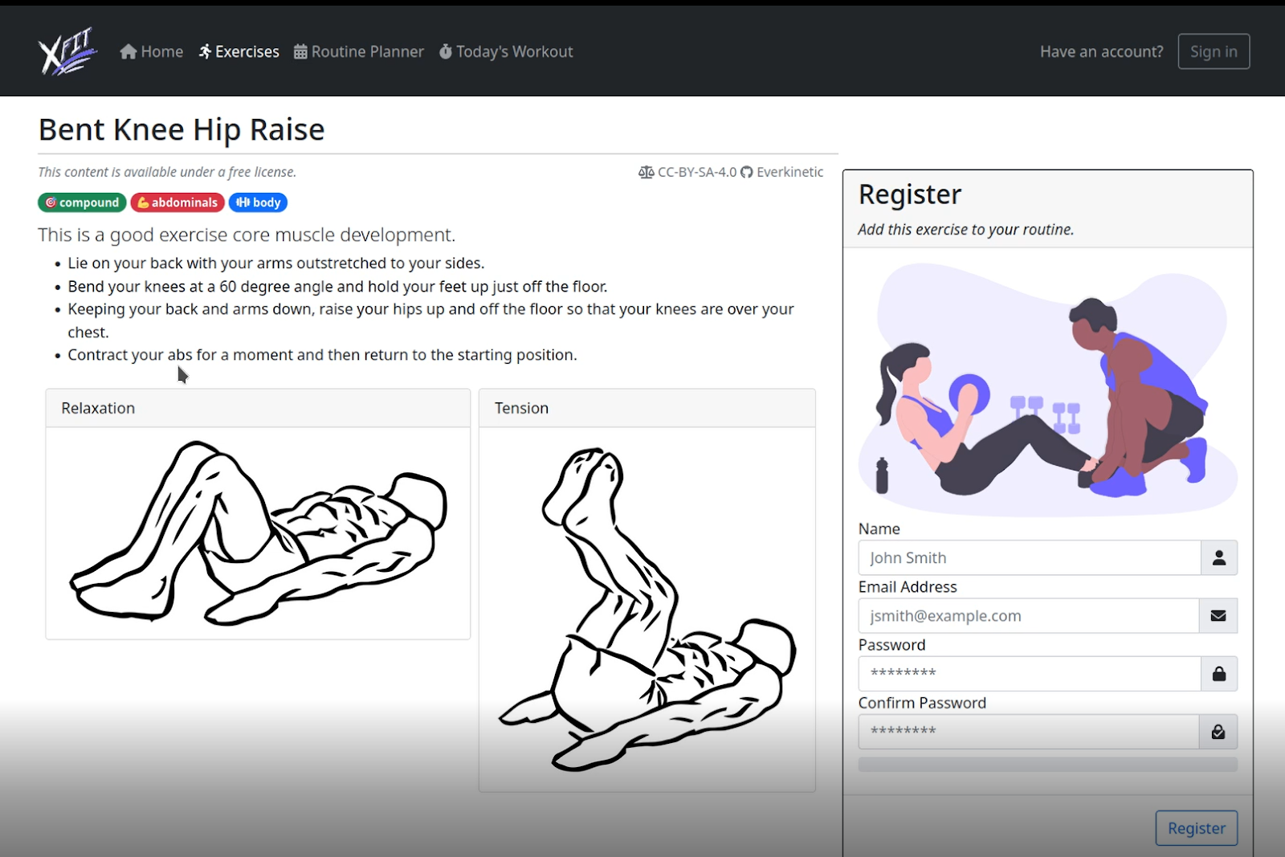
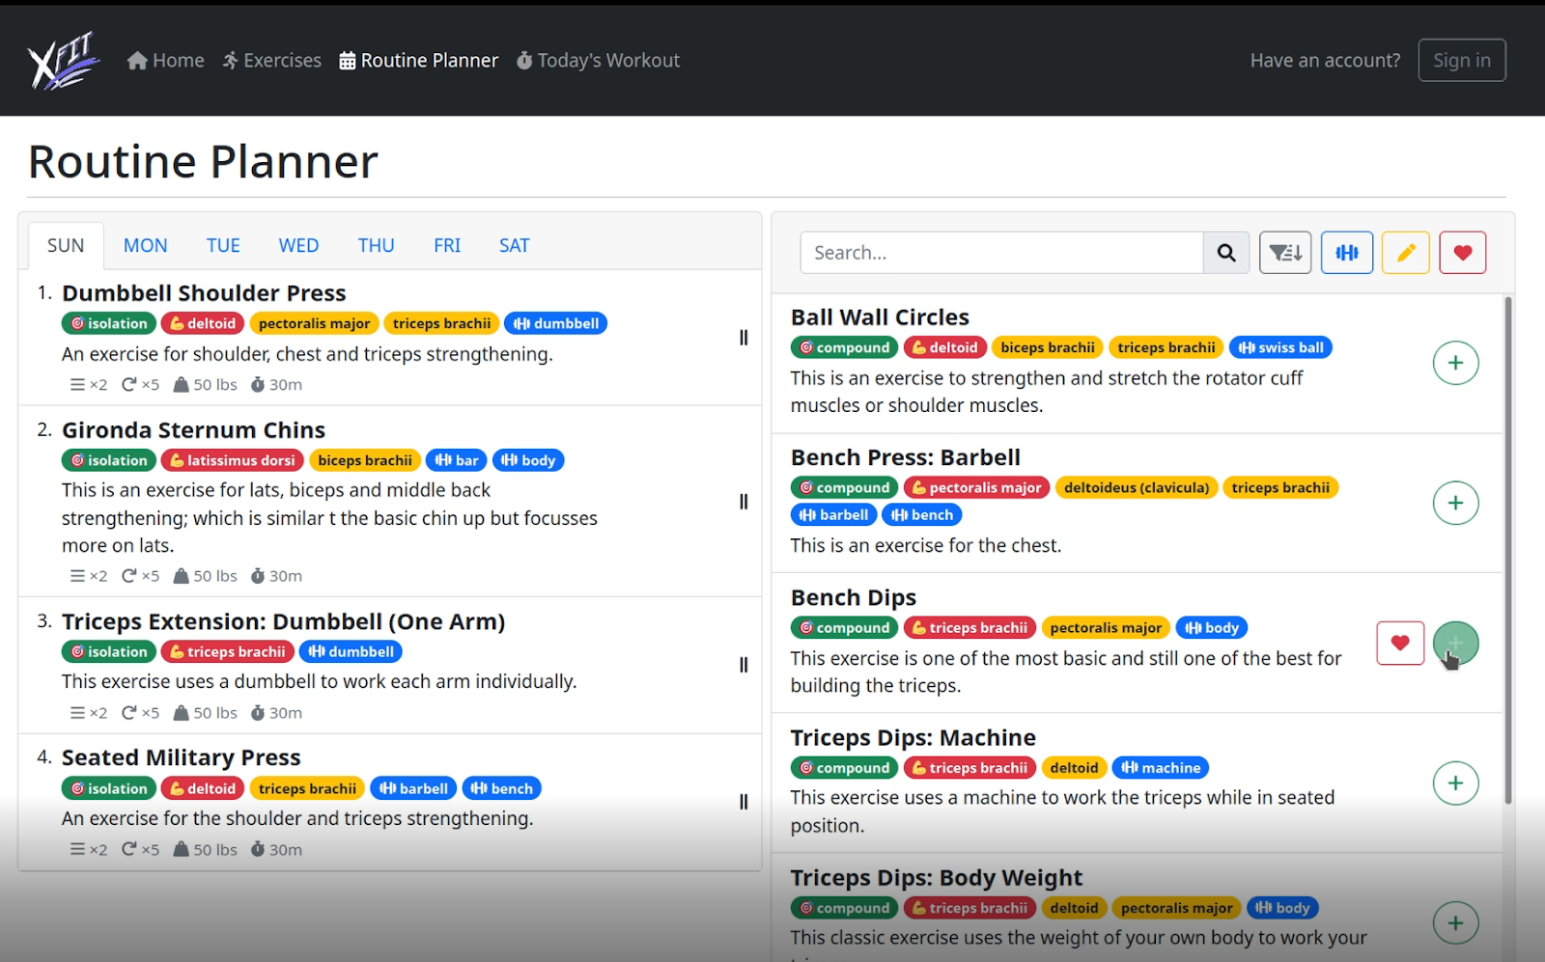
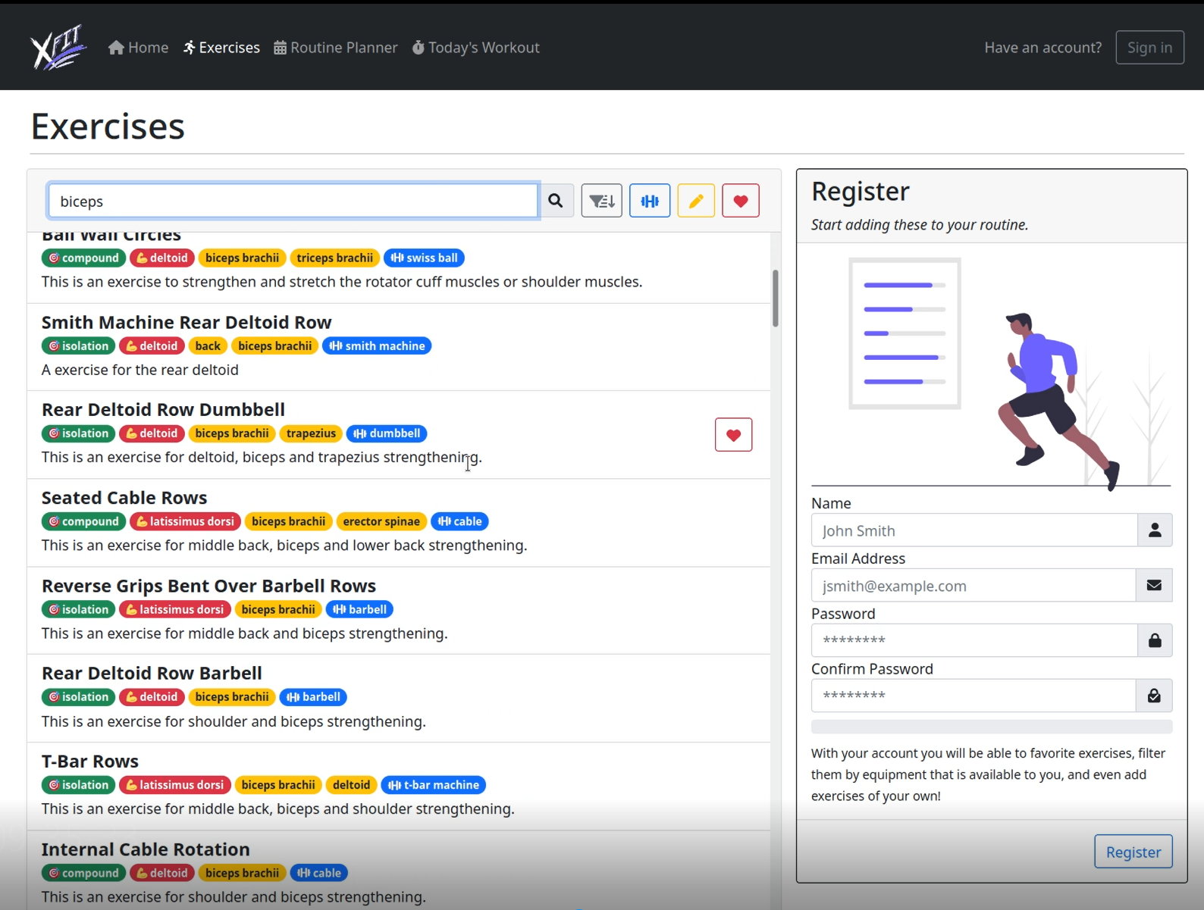
Front end Images
/ Exercise List Page Herdocia
/ Exercise Details Page Herdocia
/ Planner Page Herdocia

Slide 16
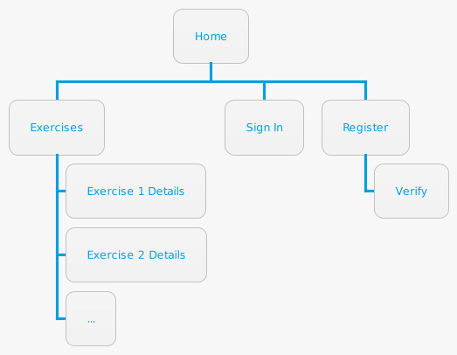
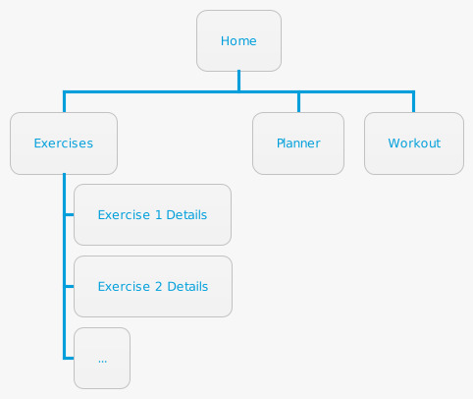
Site Map
/ While not logged in Herdocia
/ While logged in Herdocia

Slide 17
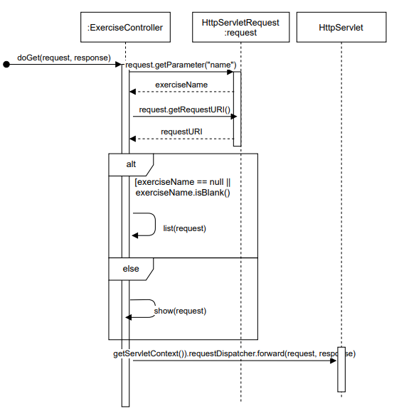
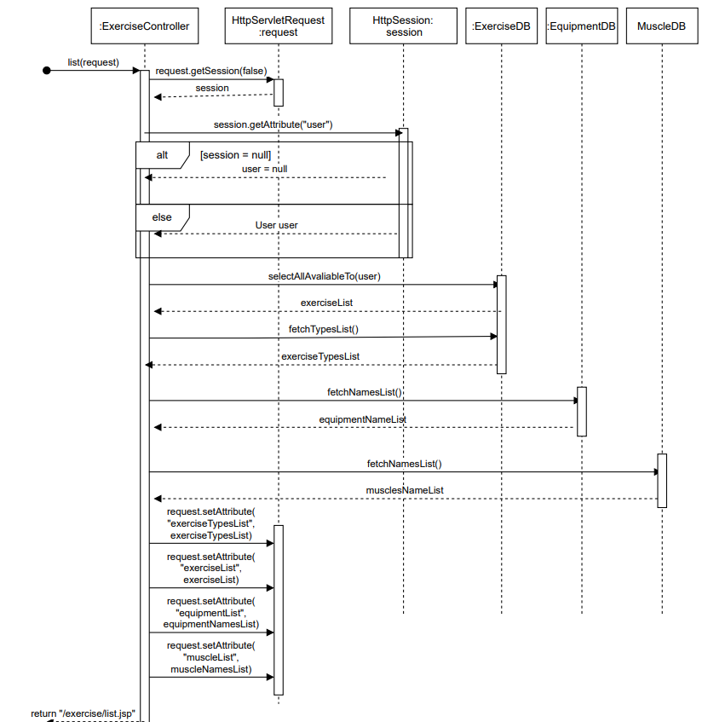
Servlet Processing Example
The Controllers like this one will call other methods defined within the servlet.
These other methods will call Utility classes or the DB classes from the methods to perform processing.
In this example, the exercise controller is using queries from the database classes of exercise, muscle, and equipment to list exercises and their details for the user.

Slide 18
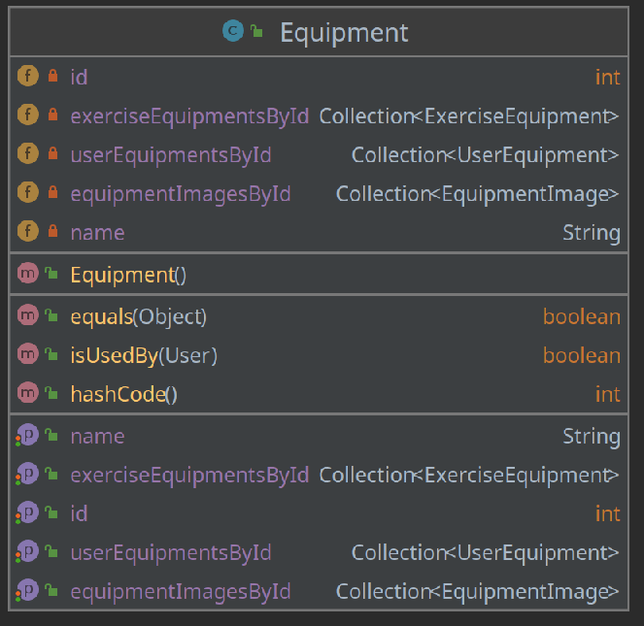
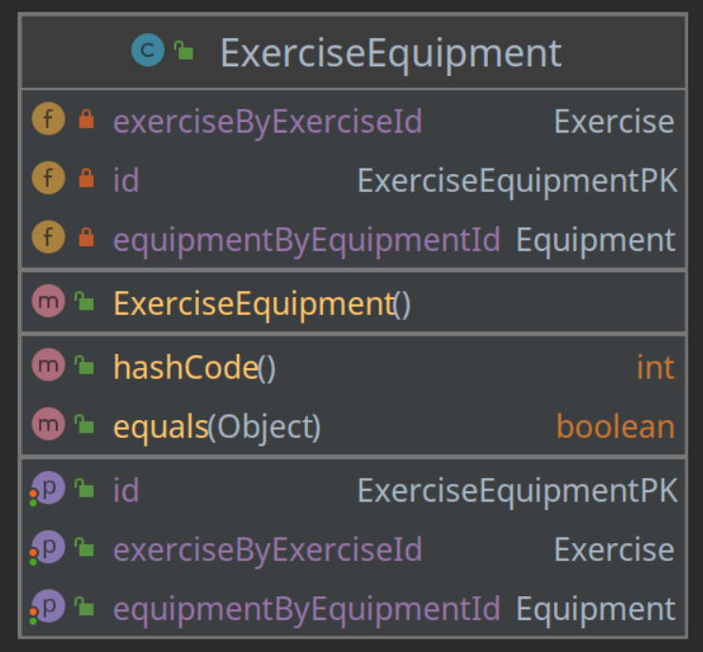
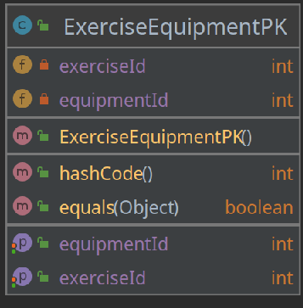
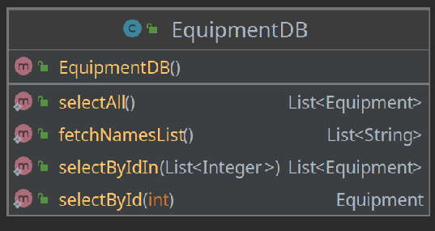
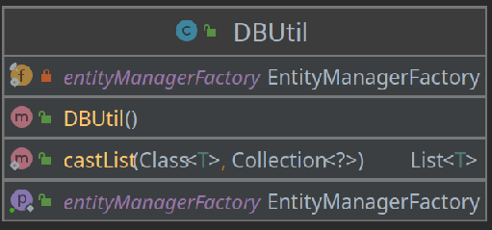
Model Design Strategies
Util classes are used for extra functionalities such as hashing a password or sending an email.
PK classes define the primary key of joint classes in the database.
Joint classes are similar to bean classes but represent the joint tables in the database.
DB classes hold the direct query methods for interacting with the database for the bean classes.
Bean classes hold the domain class properties and queries and are defined as entities for the database.

Slide 19
Testing Approach
For our unit testing, we prioritized testing for the components in our architecture that contained the most of our major processing which includes the DB classes in our model and the servlet classes from our controller.
Our DB classes test to see the returns of each method to ensure that the appropriate values are being returned given certain parameters. In the event of failure, we assume that a method will fail by expecting the appropriate thrown exception.
The Servlet classes had to be tested due to restrictions on HttpServlet response and request parameters. We simulate the appropriate method being tested with assumed values from http elements the servlet works with to see if given those assumed values, the method will return the correct result.

Slide 20
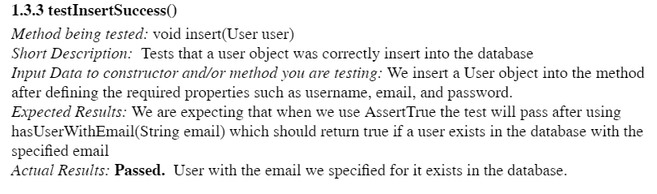
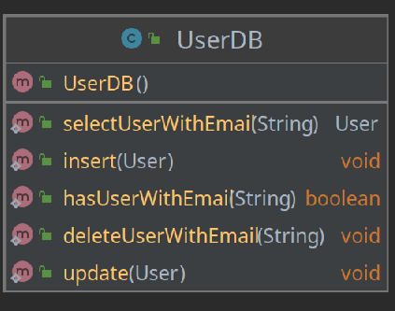
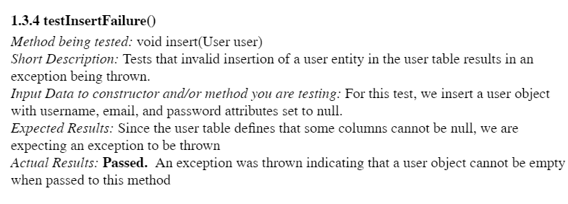
Test Case Examples

Slide 21
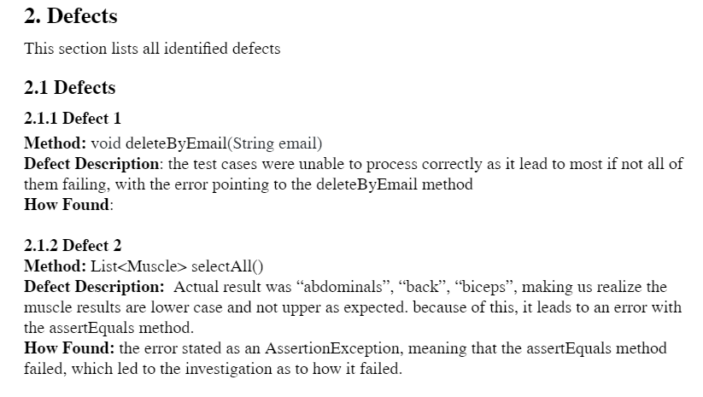
Found Defects

